Slide 1
Online Retail Store Report
By Adepegba David
(Tata Internship Task)

Slide 2
Table of Contents
Dataset Details
Dataset Cleaning
Dataset visualization
Questions
Insight
Recommendations

Slide 3
Dataset Details
InvoiceNo: These are the invoice number given to the purchase of a product from the store.
StockCode: These are the stock code for each product in the store.
Description: This is the description of the product from the store.
Quantity: This is the number of unit the customer want to buy.
InvoiceDate: This is the date the customer received the invoice of the goods.
UnitPrice: This is the unit price of each products in the store.
CustomerID: This is a unique number given to customers by the store to identify them.
Country: This is the country in which the store is located.

Slide 4
Dataset Cleaning
Before I begin the analyze, I clean the data, here are the steps:
Remove all quantity that is below 1 unit
Remove all the unit price that is below $0
Filter the order date so that I can have a complete month in a year which is 2011
Based on the CEO and CMO request, we exclude United Kingdom store from the analysis
Generating revenue. multiplying quantity by unit price row by row

Slide 5
Questions
The CEO of the retail store is interested to view the time series of the revenue data for the year 2011 only. He would like to view granular data by looking into revenue for each month. The CEO is interested in viewing the seasonal trends and wants to dig deeper into why these trends occur. This analysis will be helpful for the CEO to forecast for the next year.
The CMO is interested in viewing the top 10 countries which are generating the highest revenue. Additionally, the CMO is also interested in viewing the quantity sold along with the revenue generated. The CMO does not want to have the United Kingdom in this visual.
The CMO of the online retail store wants to view the information on the top 10 customers by revenue. He is interested in a visual that shows the greatest revenue generating customer at the start and gradually declines to the lower revenue generating customers. The CMO wants to target the higher revenue generating customers and ensure that they remain satisfied with their products.
The CEO is looking to gain insights on the demand for their products. He wants to look at all countries and see which regions have the greatest demand for their products. Once the CEO gets an idea of the regions that have high demand, he will initiate an expansion strategy which will allow the company to target these areas and generate more business from these regions. He wants to view the entire data on a single view without the need to scroll or hover over the data points to identify the demand. There is no need to show data for the United Kingdom as the CEO is more interested in viewing the countries that have expansion opportunities.

Slide 6
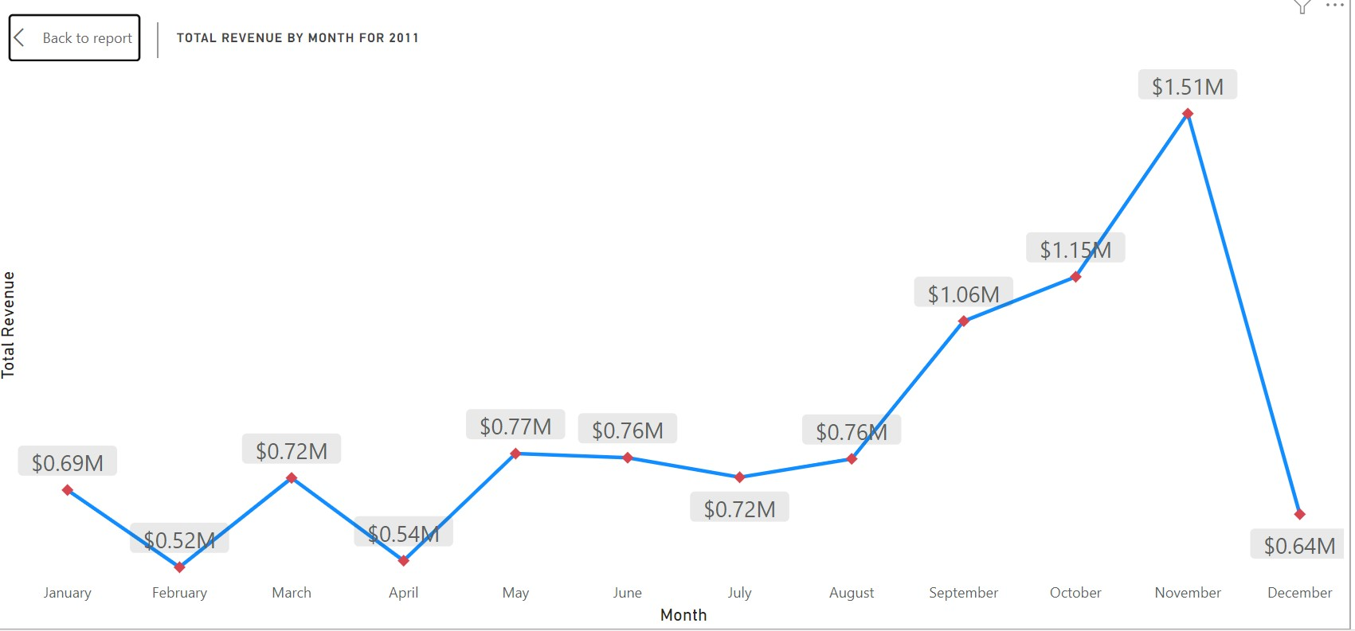

Slide 7
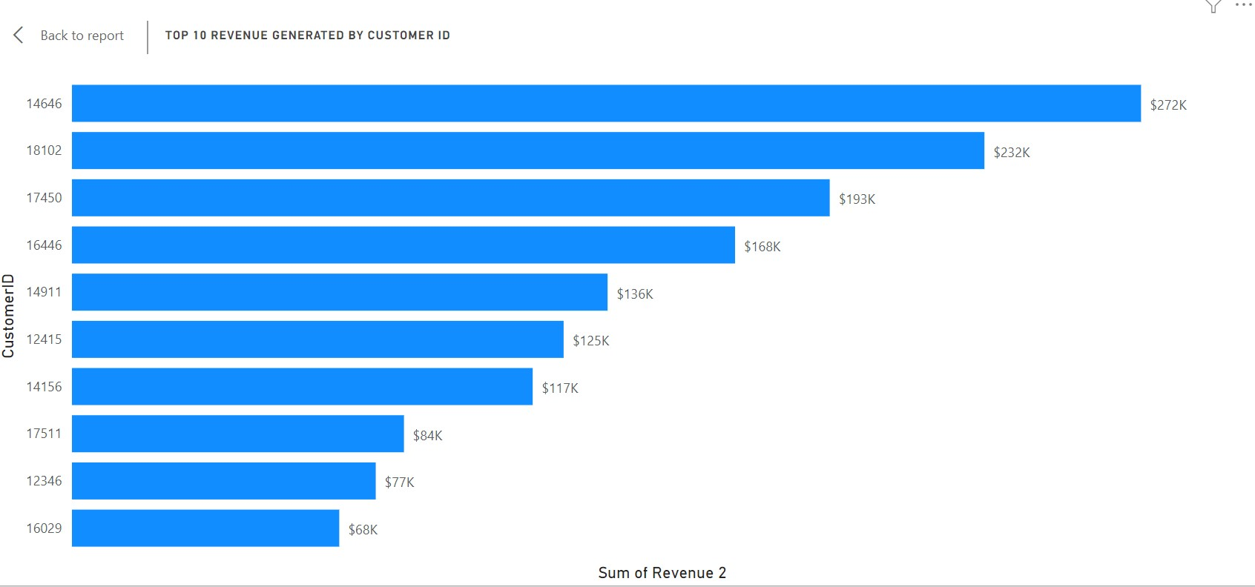

Slide 8
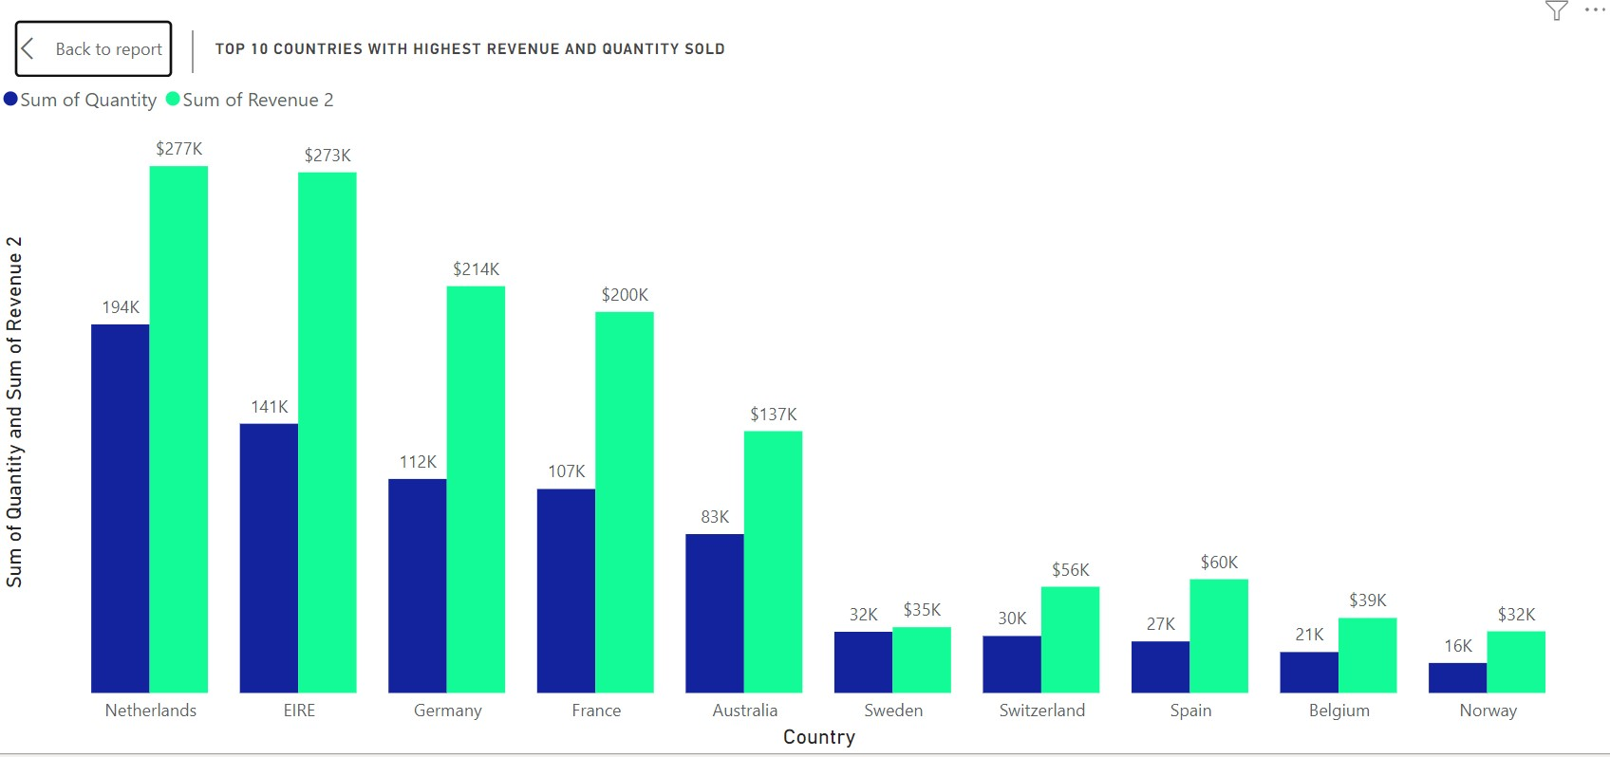

Slide 9
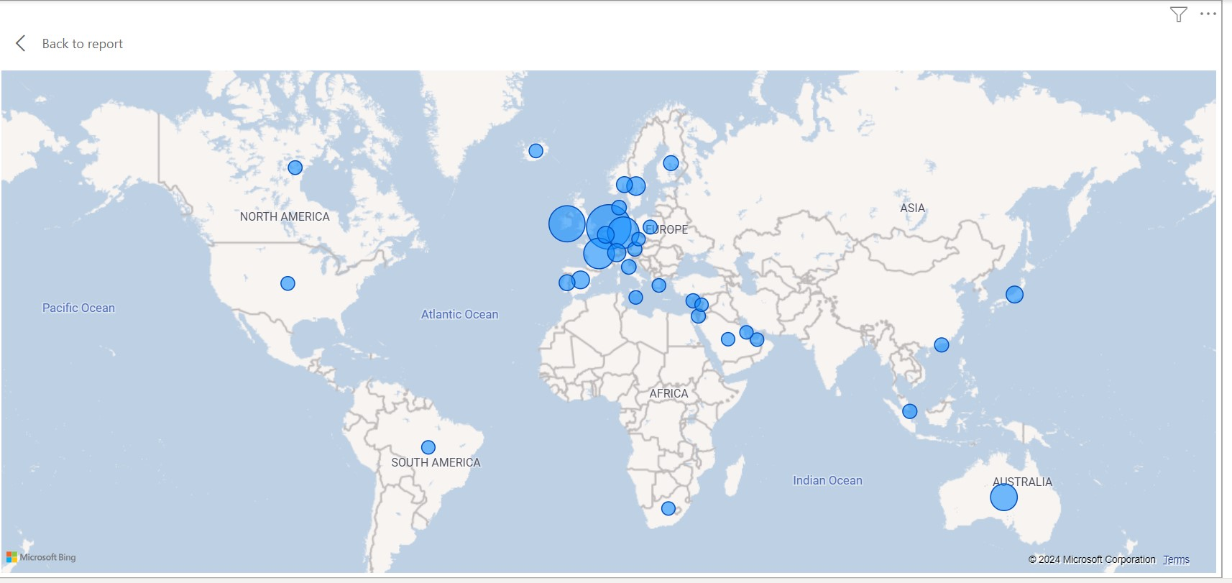

Slide 10
Insights
November had the highest revenue of $1.51 million in 2011, while February had the lowest at $0.52 million.
The store in Netherlands has the highest revenue and quantity sold, totaling $277k and $194k, respectively.
The top customer by revenue generated is 14646 customer ID, with a revenue generated from that customer of $272k.

Slide 11
Recommendations
Develop a forecasting model to predict seasonal trends and optimize inventory management.
Expand into regions with high demand.
Develop targeted marketing campaigns for top-revenue countries.
Implement loyalty programs to retain high-revenue.
Consider expanding product offerings to cater to high-demand regions.
Develop a customer relationship management (CRM) system to track customer interactions.

Slide 12
THANK YOU

